Slide 1
User Interaction and Intuitive Navigation
Android Developer Fundamentals
Lesson 4
This work is licensed under a Creative Commons Attribution-NonCommercial 4.0 International License

Slide 2
4.4 Recycler View
This work is licensed under a Creative Commons Attribution-NonCommercial 4.0 International License

Slide 3
Contents
RecyclerView Components
Implementing a RecyclerView

Slide 4
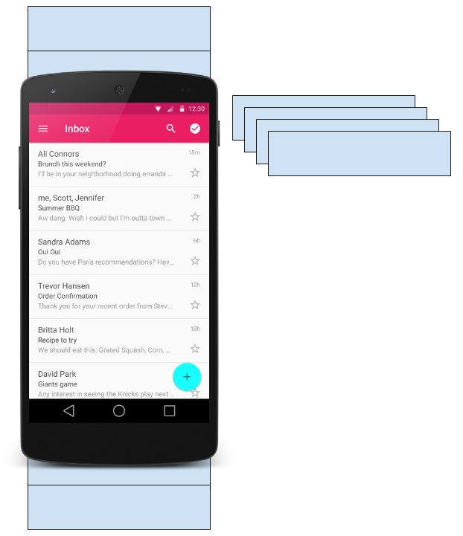
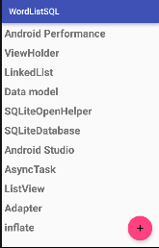
What is a Recycler View?
Scrollable container for large data sets
Efficient
uses and reuses limited number of views
Updates changing data fast
RecyclerView

Slide 5
RecyclerView Components

Slide 6
Components
All Components overview
Data
RecyclerView scrolling list for list items—RecyclerView
Layout for one item of data—XML file
Layout manager handles the organization of UI components in a view—Recyclerview.LayoutManager
Adapter connects data to the RecyclerView—RecyclerView.Adapter
View holder has view information for displaying one item—RecyclerView.ViewHolder

Slide 7
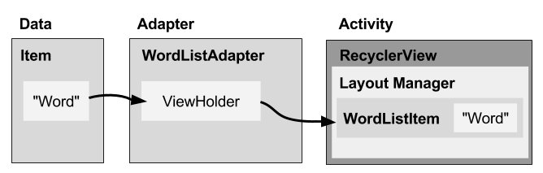
Components
How components fit together overview

Slide 8
Layout Manager
What is a layout manager?
All view groups have layout managers
Positions item views inside a RecyclerView.
Reuses item views that are no longer visible to the user
Built-in layout managers include LinearLayoutManager, GridLayoutManager, and StaggeredGridLayoutManager
For RecyclerView, extend RecyclerView.LayoutManager

Slide 9
Adapter
What is an adapter?
Helps incompatible interfaces work together, for example, takes data from a database Cursor and puts them as strings into a view
Intermediary between data and view
Manages creating, updating, adding, deleting item views as the underlying data changes
RecyclerView.Adapter

Slide 10
Adapter
What is a view holder?
Used by the adapter to prepare one view with data for one list item
Layout specified in an XML resource file
Can have clickable elements
Is placed by the layout manager
RecyclerView.ViewHolder

Slide 11
Implementing RecyclerView

Slide 12
Implementation
Steps Summary
Add the RecyclerView dependency to app/build.gradle file
Add RecyclerView to layout
Create XML layout for item
Extend RecyclerView.Adapter
Extend RecyclerView.ViewHolder
In onCreate of activity, create a RecyclerView with adapter and layout manager

Slide 13
app/build.gradle
Add dependency to app/build.gradle
dependencies {
...
compile 'com.android.support:recyclerview-v7:24.1.1'
...
}

Slide 14
Activity layout
Add RecyclerView to XML Layout
<android.support.v7.widget.RecyclerView
android:id="@+id/recyclerview"
android:layout_width="match_parent"
android:layout_height="match_parent">
</android.support.v7.widget.RecyclerView>

Slide 15
Item layout
Create layout for 1 list item
<LinearLayout …>
<TextView
android:id="@+id/word"
style="@style/word_title" />
</LinearLayout>

Slide 16
Adapter: Create
Implement the adapter
public class WordListAdapter
extends RecyclerView.Adapter<WordListAdapter.WordViewHolder> {
public WordListAdapter(Context context,
LinkedList<String> wordList) {
mInflater = LayoutInflater.from(context);
this.mWordList = wordList;
}
}

Slide 17
Adapter: onCreateViewHolder()
Adapter has 3 required methods
onCreateViewHolder()
inBindViewHolder()
getItemCount()
Let's take a look!

Slide 18
Adapter: onCreateViewHolder()
onCreateViewHolder()
@Override
public WordViewHolder onCreateViewHolder( ViewGroup parent, int viewType) {
// Create view from layout
View mItemView = mInflater.inflate(
R.layout.wordlist_item, parent, false);
return new WordViewHolder(mItemView, this);
}

Slide 19
Adapter: onBindViewHolder()
onBindViewHolder()
@Override
public void onBindViewHolder( WordViewHolder holder, int position) {
// Retrieve the data for that position
String mCurrent = mWordList.get(position);
// Add the data to the view
holder.wordItemView.setText(mCurrent);
}

Slide 20
Adapter: getItemCount()
getItemCount()
@Override
public int getItemCount() {
// Return the number of data items to display
return mWordList.size();
}

Slide 21
Adapter: ViewHolder Class
Create the view holder in adapter class
class WordViewHolder extends RecyclerView.ViewHolder {}
If you want to handle mouse clicks:
class WordViewHolder extends RecyclerView.ViewHolder
implements View.OnClickListener {}

Slide 22
ViewHolder: Constructor
View holder constructor
public WordViewHolder(View itemView, WordListAdapter adapter) {
super(itemView);
// Get the layout
wordItemView = (TextView) itemView.findViewById(R.id.word);
// Associate with this adapter
this.mAdapter = adapter;
// Add click listener, if desired
itemView.setOnClickListener(this);
}
// Implement onClick() if desired

Slide 23
Create RecyclerView
Create the RecyclerView in activity's onCreate()
mRecyclerView = (RecyclerView)
findViewById(R.id.recyclerview);
mAdapter = new WordListAdapter(this, mWordList);
mRecyclerView.setAdapter(mAdapter);
mRecyclerView.setLayoutManager(new
LinearLayoutManager(this));

Slide 24
Practical: RecyclerView
This is rather complex with many separate pieces. So, there is a whole practical where you implement a RecyclerView that displays a list of clickable words.
Shows all the steps, one by one with a complete app

Slide 25
Learn more
RecyclerView
RecyclerView class
RecyclerView.Adapter class
RecyclerView.ViewHolder class
RecyclerView.LayoutManager class

Slide 26
What's Next?
Concept Chapter: 4.4 C RecyclerView
Practical: 4.4 P Create a Recycler View

Slide 27
END

